Slide 1
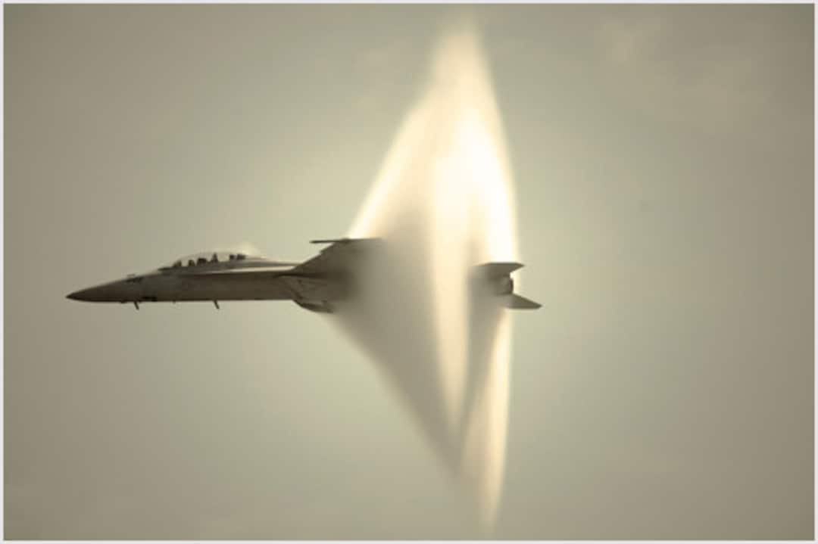

Quiet Supersonic Aircraft
When an object surpasses the speed of sound, air starts to behave like a fluid. As an object travels through the air, the air molecules are pushed aside with greater force and forms a shock wave like how a boat produces a bow wave. The sharp release of pressure, after the build up by the shock wave, is heard as the sonic boom. This sonic boom is the reason why non-military aircraft cannot exceed the speed of sound over land, as the shockwave generated can cause structural damage and disrupt wildlife. However, new approaches to aircraft design and Mach cutoff physics are leading the way to supersonic aircraft producing a low or negligible boom.

Slide 2
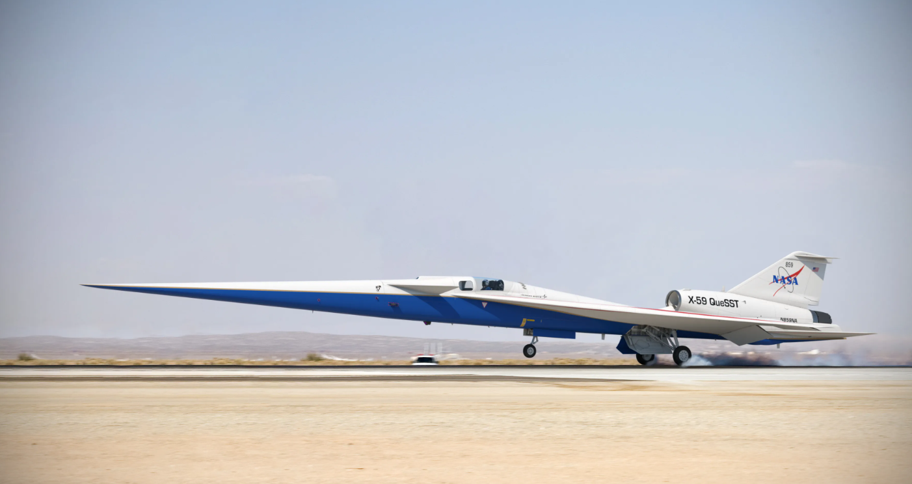
The X-59:
Minimising shock waves:
Engine sits on wings
T-tail to reduce aft shock
Long nose(11m):
Helps break up pressure waves
Cockpit in middle of aircraft:
No forward-facing windows
Antistatic paint
eXternal Vision system
Notes:
The X-59 is an example of a low boom aircraft. It achieves this by its unusual design. The most obvious feature of this aircraft is the nose of the plane, which stretches 11m and is roughly one third of the plane’s length. This long nose helps break up the pressure waves that would form a sonic boom with outer mould lines that help disperse the waves(NASA, n.d.). The resulting supersonic heartbeat is much quieter than the disruptive N-wave boom generated by current aircraft. Because the X-59 has such a long nose, the cockpit is postioned in the middle of the aircraft and is integrated seamlessly into the aircrafts frame that it has no forward-facing windows to reduce air drag. Instead, the X-59 uses 4k cameras known as the eXternal Vision System (Bailey, 2022) that produce a live feed of what is in front of the aircraft. Other design features that minimise the number of waves that can reach the ground are having the engine sit on top of the wings and utilising a T-tail to reduce aft shock(Bailey, 2022). Finally, the X-59 uses an antistatic paint, to avoid static electricity buildup on the aircrafts surface, which could affect electrical equipment(NASA, n.d.).
The X-59 had its maiden flight on October 28th 2025, where it flew for around 67 minutes at a max speed of 230 miles per hour, and at around 12,000 feet. This was the first of the X-59's flight tests, as NASA aim to have the aircraft flying supersonic speeds soon to test the community response on the loudness of the sonic booms, to potentially allow commercial supersonic flights over land in the future(NASA, 2025).

Slide 3
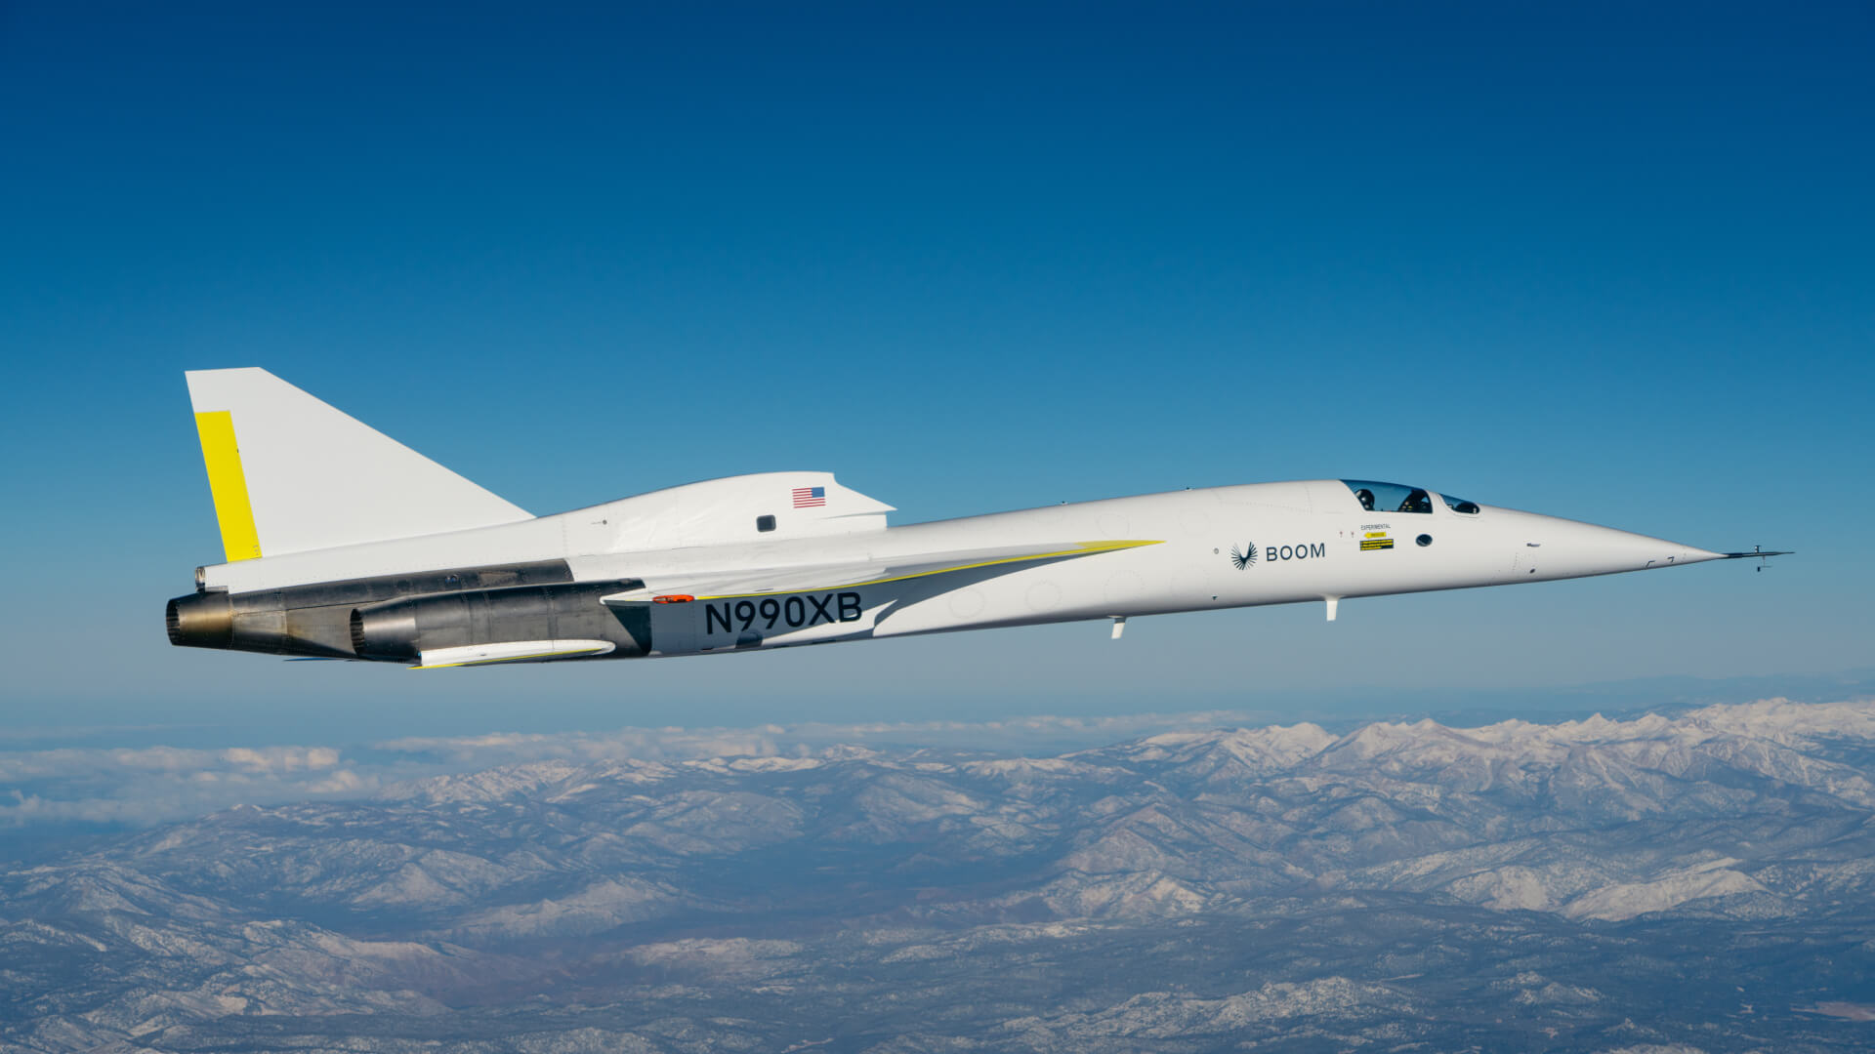
The X-B1:
The XB-1 is an example of an aircraft that uses Mach cutoff physics to produce inaudible waves at ground level, so still technically produces a normal sonic boom. The XB-1 went supersonic for the first time on 28 January 2025 and on the 10th February 2025 broke the sound barrier three times during the flight without an audible boom reaching the ground. The XB-1 achieved this with its Boomless Cruise technology made possible by its Symphony engines- which generate 40,000 pounds of thrust allowing the XB-1 to go supersonic above 30,000 feet using enhanced transonic performance.

Slide 4
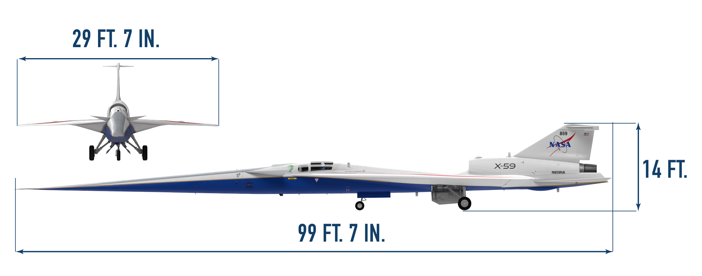
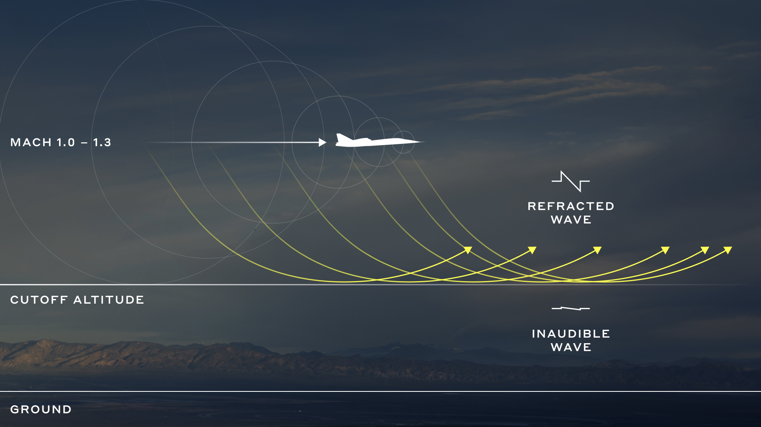
Differences between Low Boom and Boomless Cruise:
Low Boom
Boomless Cruise
The X-59’s unique shape allows it to reduce the decibels of the sonic boom to Lockheed Martin's target of 75 by separating the pressure waves that form, effectively reducing the booms strength to the sound of slamming a car door.
Boomless Cruise utilises well-known Mach cutoff physics, where a sonic boom refracts upwards due to temperature and wind gradients affecting the local speed of sound. This is similar to how light bends as it goes through a denser medium, such as air to water. By flying at a sufficiently high altitude and at the correct speed for current atmospheric conditions, XB-1 can ensure that its sonic boom created will never reach the ground.

Slide 5
Future Plans:
X-59
XB-1
Collect community response data on the acceptability of a quiet sonic boom
The data will help NASA provide regulators with the information needed to establish an acceptable commercial supersonic noise standard to lift the ban on commercial supersonic travel over land.
This data could help open a new door to an entirely new global market for aircraft manufacturers
The X-59's other goal is to continue experimenting with reducing the strength of sonic boom
Use the XB-1 as a supersonic demonstrator aircraft
Scale it up into the Overture class- a commercial supersonic airliner
During flight, Overture will take advantage of the Boomless Cruise technology demonstrated in the XB-1 to eliminate the sonic boom.
No afterburners to reduce noise during take-off and landing.

